Slide 1
K Server

Slide 2
K Server
The K-server problem:
Problem considered from the perspective of online algorithms and competitive analysis
Given a metric space S, K mobile servers are initially located at some predefined points in that space.
Over time, service requests appear successively at different locations in the
space.
Upon knowing the location of the request, one has to immediately dispatch one of K servers to this location.
The cost associated with the assignment is the distance between the location of the server and the location of the request.
The objective is to minimize the total cost of serving requests, that is the sum of distances traveled by all servers over a given time horizon.
The goal of the algorithm is to keep the total distance all servers move small, relative to the total distance the servers could have moved by an optimal adversary who knows in advance the entire sequence of requests.
Notes:
B0=0
B1 = B0+1 B2 = B1+B0+1,
Bi = Bi-1 + … + B1 +B0 + 1
Bi-1 = Bi-2 + B1 +B0 + 1
Bi-Bi-1 = Bi-1, Bi= 2Bi-1

Slide 3
K Server
The K-server problem:
The typical setting for the K-server problem requires that assignments be made in online fashion, that is, by considering only the current and the past requests.
The offline version of the K-server is to find an optimal strategy of serving a finite sequence of known requests.
In the online context, one does not have information about precise locations of future requests,
this is why online algorithms may incur significantly worse costs than an optimal offline method.
One of the common ways to assess the quality of an online algorithm is via its competitive ratio, that is the worst-case ratio between the performance of the online algorithm and the optimal offline over all instances of the problem
Notes:
B0=0
B1 = B0+1 B2 = B1+B0+1,
Bi = Bi-1 + … + B1 +B0 + 1
Bi-1 = Bi-2 + B1 +B0 + 1
Bi-Bi-1 = Bi-1, Bi= 2Bi-1

Slide 4
K Server
Competitive Analysis:
Competitive analysis is a method invented for analyzing online algorithms, in which the performance of an online algorithm (which must satisfy an unpredictable sequence of requests, completing each request without being able to see the future) is compared to the performance of an optimal offline algorithm that can view the sequence of requests in advance.
An algorithm is competitive if its competitive ratio—the ratio between its performance and the offline algorithm's performance is bounded.
Notes:
B0=0
B1 = B0+1 B2 = B1+B0+1,
Bi = Bi-1 + … + B1 +B0 + 1
Bi-1 = Bi-2 + B1 +B0 + 1
Bi-Bi-1 = Bi-1, Bi= 2Bi-1

Slide 5
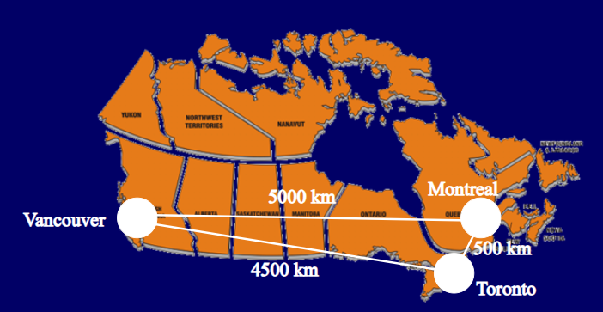
K Server
Competitive Analysis:
Notes:
B0=0
B1 = B0+1 B2 = B1+B0+1,
Bi = Bi-1 + … + B1 +B0 + 1
Bi-1 = Bi-2 + B1 +B0 + 1
Bi-Bi-1 = Bi-1, Bi= 2Bi-1

Slide 6
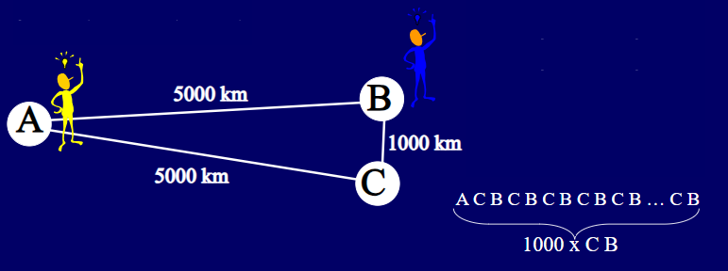
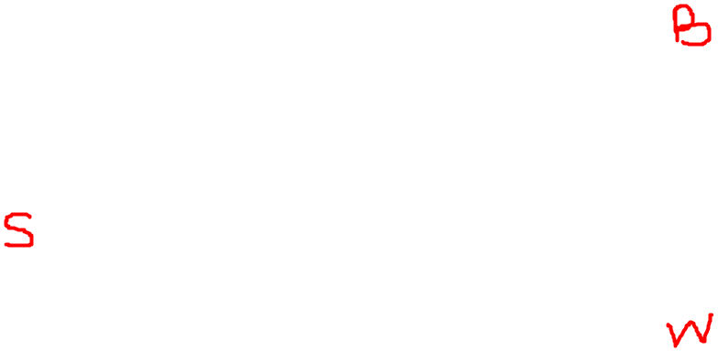
K Server
To make the problem more concrete, imagine sending customer support technicians to customers when they have trouble with their equipment. In our example problem there are two technicians, Mary and Noah, serving three customers, in San Francisco, California; Washington, DC; and Baltimore, Maryland. As a k-server problem, the servers are the technicians, so k = 2 and this is a 2-server problem. Washington (B) and Baltimore ( C ) are 35 miles (56 km) apart, while San Francisco (A) is 3,000 miles (4,800 km) away from both, and initially Mary and Noah are both in San Francisco.
Notes:
B0=0
B1 = B0+1 B2 = B1+B0+1,
Bi = Bi-1 + … + B1 +B0 + 1
Bi-1 = Bi-2 + B1 +B0 + 1
Bi-Bi-1 = Bi-1, Bi= 2Bi-1

Slide 7
K Server
To make the problem more concrete, imagine sending customer support technicians to customers when they have trouble with their equipment. In our example problem there are two technicians, Mary and Noah, serving three customers, in San Francisco, California; Washington, DC; and Baltimore, Maryland. As a k-server problem, the servers are the technicians, so k = 2 and this is a 2-server problem. Washington and Baltimore are 35 miles (56 km) apart, while San Francisco is 3,000 miles (4,800 km) away from both, and initially Mary and Noah are both in San Francisco.
Algorithm:
Consider an algorithm for assigning servers to requests that always assigns the closest server to the request, and suppose that each weekday morning the customer in Washington needs assistance while each weekday afternoon the customer in Baltimore needs assistance, and that the customer in San Francisco never needs assistance.
Notes:
B0=0
B1 = B0+1 B2 = B1+B0+1,
Bi = Bi-1 + … + B1 +B0 + 1
Bi-1 = Bi-2 + B1 +B0 + 1
Bi-Bi-1 = Bi-1, Bi= 2Bi-1

Slide 8
K Server
Then, our algorithm will assign one of the servers (say Mary) to the Washington area, after which she will always be the closest server and always be assigned to all customer requests.
Thus, every day our algorithm incurs the cost of traveling between Washington and Baltimore and back, 70 miles (110 km).
After a year of this request pattern, the algorithm will have incurred 20,500 miles (33,000 km) travel: 3,000 to send Mary to the East Coast, and 17,500 for the trips between Washington and Baltimore.
On the other hand, an optimal adversary who knows the future request schedule could have sent both Mary and Noah to Washington and Baltimore respectively, paying 6,000 miles (9,700 km) of travel once but then avoiding any future travel costs.
The competitive ratio of our algorithm on this input is 20,500/6,000 or approximately 3.4, and by adjusting the parameters of this example the competitive ratio of this algorithm can be made arbitrarily large.
Notes:
B0=0
B1 = B0+1 B2 = B1+B0+1,
Bi = Bi-1 + … + B1 +B0 + 1
Bi-1 = Bi-2 + B1 +B0 + 1
Bi-Bi-1 = Bi-1, Bi= 2Bi-1

Slide 9
K Server
Then, our algorithm will assign one of the servers (say Mary) to the Washington area, after which she will always be the closest server and always be assigned to all customer requests.
Thus, every day our algorithm incurs the cost of traveling between Washington and Baltimore and back, 70 miles (110 km).
After a year of this request pattern, the algorithm will have incurred 20,500 miles (33,000 km) travel: 3,000 to send Mary to the East Coast, and 17,500 for the trips between Washington and Baltimore.
On the other hand, an optimal adversary who knows the future request schedule could have sent both Mary and Noah to Washington and Baltimore respectively, paying 6,000 miles (9,700 km) of travel once but then avoiding any future travel costs.
The competitive ratio of our algorithm on this input is 20,500/6,000 or approximately 3.4, and by adjusting the parameters of this example the competitive ratio of this algorithm can be made arbitrarily large.
Notes:
B0=0
B1 = B0+1 B2 = B1+B0+1,
Bi = Bi-1 + … + B1 +B0 + 1
Bi-1 = Bi-2 + B1 +B0 + 1
Bi-Bi-1 = Bi-1, Bi= 2Bi-1

Slide 10
K Server
Thus we see that always assigning the closest server can be far from optimal. On the other hand, it seems foolish for an algorithm that does not know future requests to send both of its technicians away from San Francisco, as the next request could be in that city and it would have to send someone back immediately. So it seems that it is difficult or impossible for a k-server algorithm to perform well relative to its adversary. However, for the 2-server problem, there exists an algorithm that always has a total travel distance of at most twice the adversary's distance. The k-server conjecture states that similar solutions exist for problems with any larger number of technicians.
Notes:
B0=0
B1 = B0+1 B2 = B1+B0+1,
Bi = Bi-1 + … + B1 +B0 + 1
Bi-1 = Bi-2 + B1 +B0 + 1
Bi-Bi-1 = Bi-1, Bi= 2Bi-1

Slide 11
K Server
Solution:
1. Work Function algorithm
2. Randomized Algorithm
Notes:
B0=0
B1 = B0+1 B2 = B1+B0+1,
Bi = Bi-1 + … + B1 +B0 + 1
Bi-1 = Bi-2 + B1 +B0 + 1
Bi-Bi-1 = Bi-1, Bi= 2Bi-1

